Slide 1





00
The Problem
PLAYLIST RECOMMENDER SYSTEM
BUSINESS QUESTION?
"How can we develop a system to recommend personalized playlists to users, leveraging playlist data alone to identify contextual relationships between songs and generate relevant suggestions for a given input song?"
Data Science course 2024-2025
Created by Manor Shpritz, Ortal Lasry and Or Cohen Raviv.
GITHAB link
*Spotify logo and data are copyrighted by Spotify and used for educational purposes only.

Slide 2
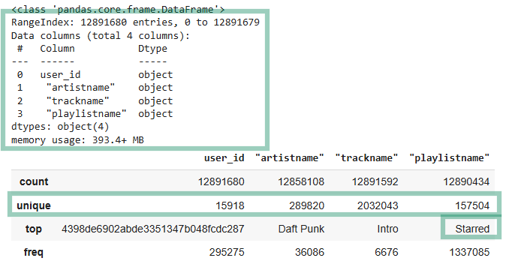
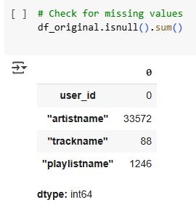
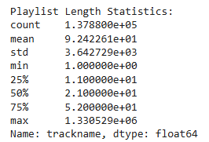
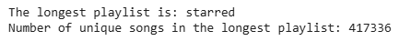
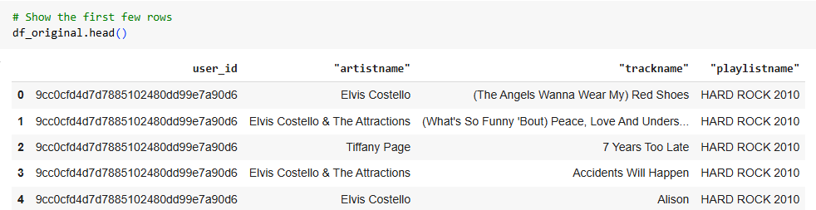
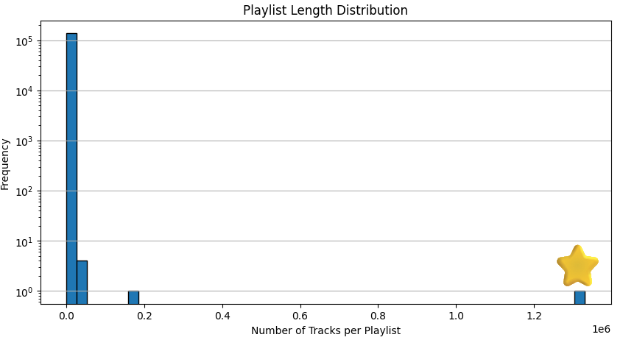

01
Data and Features
Original data, features, data cleaning and EDA
Raw data: Over 12.7 million rows
Unique tokens : 121,471 unique tokens (distinct elements, like songs or artists) in "starred" playlists.
Rare Tokens: Out of these, 55,529 tokens (45.7%) appear only once in the entire dataset, marking them as rare.
Key Insight: This high proportion of rare tokens indicates that "starred" playlists introduce a significant amount of noise.
Data Set from Kaggle: Spotify-playlists

Slide 3
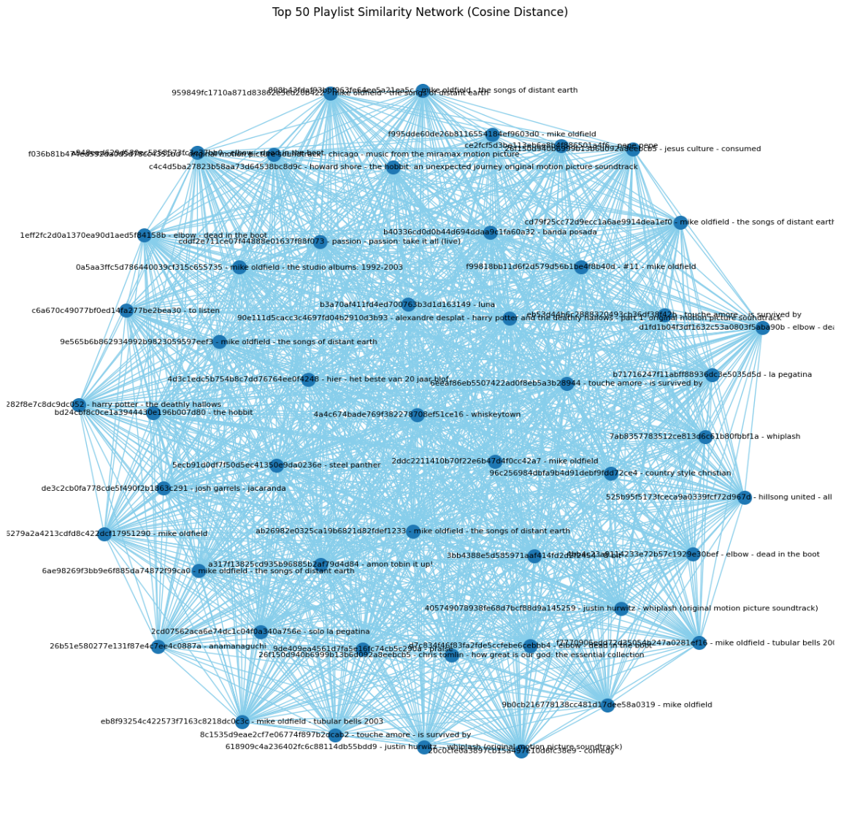
02
Words2vec Model
TOKENS
SIMILARITY MAP
Converts each playlist into a list of song names (tokens). Eeach playlist becomes a "sentence," and each “song” becomes a "word" in that sentence.
Basic similarity map:
Establishes connections between playlists based on shared (overlap) songs.
.
Cosine-Based Similarity Map
Each playlist is represented by its average vector, and connections between playlists are based on cosine similarity between these vectors.
WORDS2VEC
Word2Vec represents songs as vectors in a multi-dimensional space (dense vector).
Songs that are closer to each other in this vector space are likely to co-occur in playlists and share similar characteristics. Therefore, these songs are recommended together
EVALUATION OF THE MODEL
PRECISION=1.00
RECALL=0.19
F1 SCORE: 0.32

Slide 4
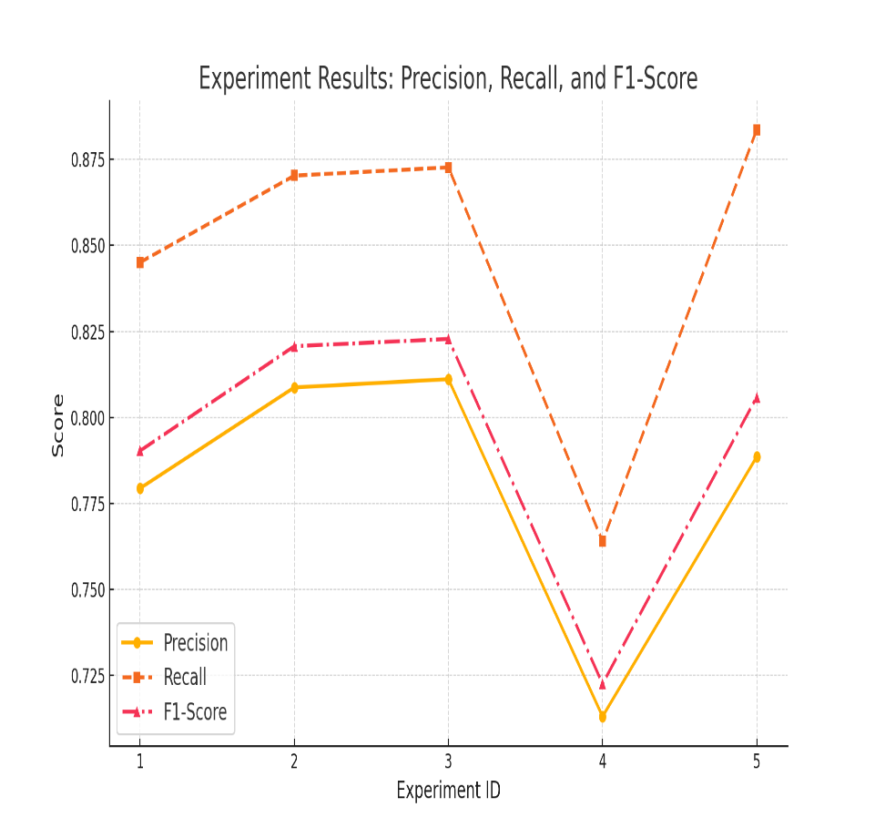
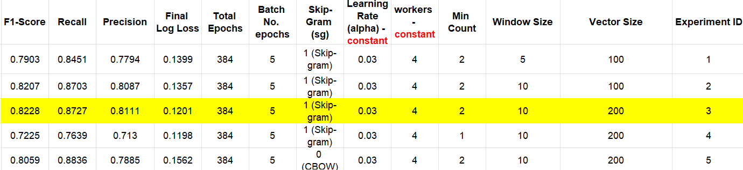
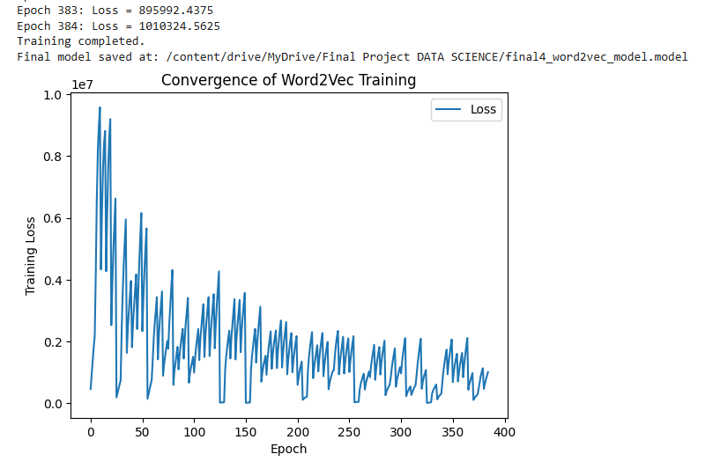
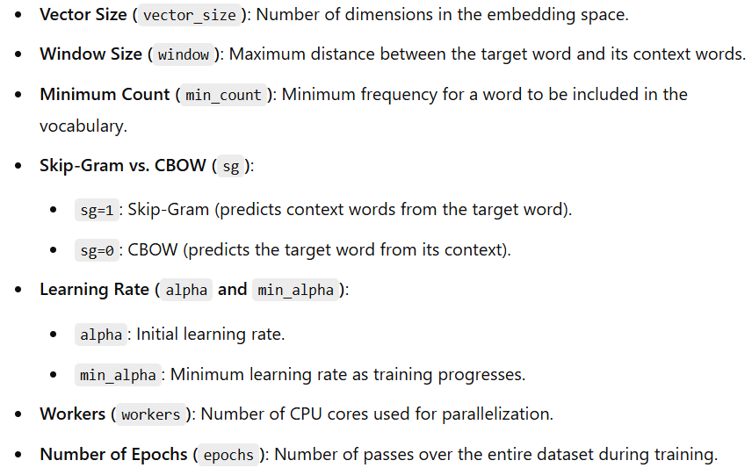
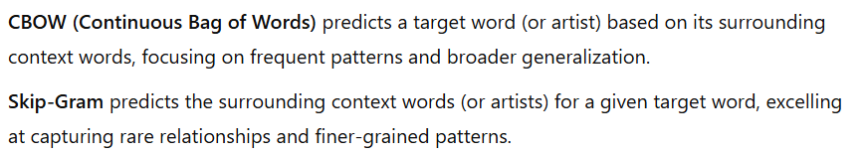
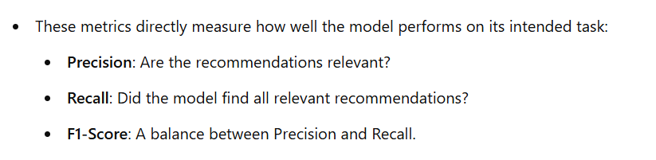
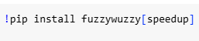
03
Words2vec artist-based Model
Best model chosen is 3 based on best F1 score

Slide 5
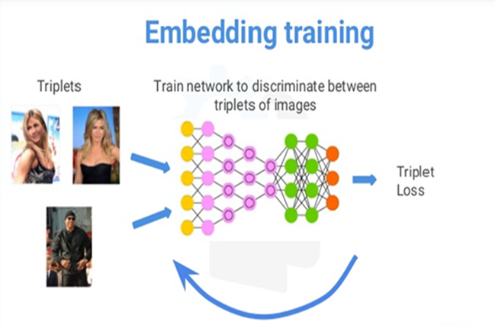
04
Siamese network
SIAMESE NETWORK
Siamese Network
•Pairwise Similarity: Can analyze songs pairs
•Flexibility: Learns embeddings that adapt to new playlists.
•Sparse Data Efficiency: Manages implicit song relationships in large, sparse datasets.
•Loss Function - Triplet Loss: Ensures songs in the same playlist are closer in the embedding space than those that are unrelated.
Triplet Structure:
•Anchor Song
A song from the playlist.
•Positive Song
Another song from the same playlist.
•Negative Song
A song not in the playlist.
•Triplet Generation Process:
•Balanced Sampling of Easy Negatives and Hard Negatives:
•Diversity Logic to ensure wide coverage of songs.
Validation
Probability Calculation:
Cosine similarity between embeddings
Ranking Metrics:
Precision@K
Recall@K
Mean Average Precision (MAP).

Slide 6
05
Challenges
Challenges of the Project
Long Execution Time: The runtime for various stages of the project was significantly long, making iterative experimentation challenging.
Limited Features: The original dataset was based on only four features.
Data Integration Limitations: Due to the large number of songs in the dataset, we couldn't integrate external databases to enrich the data with additional demographic or user-related information.
Collaboration Bottlenecks: While we aimed to work collaboratively, the extended runtime made it difficult to wait for each other's progress, except during the exploratory data analysis phase.
Cold Start Problem-Songs and playlists with no overlap in the training data couldn't generate meaningful predictions, resulting in missed recommendations.
Word2Vec Limitations: The Word2Vec model doesn't consider the order of songs in playlists, which might impact capturing the contextual relationships between songs.
75% of the songs appear in no more than 2 unique playlists. This indicates a very limited variety for recommendations based on similar songs or playlists.

Slide 7

06
APPENDIX
APPENDIX

Slide 8
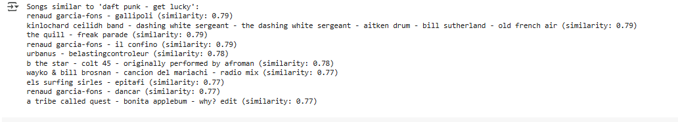
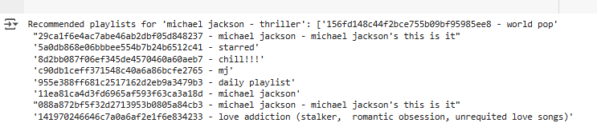
07
APPENDIX
APPENDIX 1
Songs similar to input song:
Recommend Playlists for a Song:

Slide 9
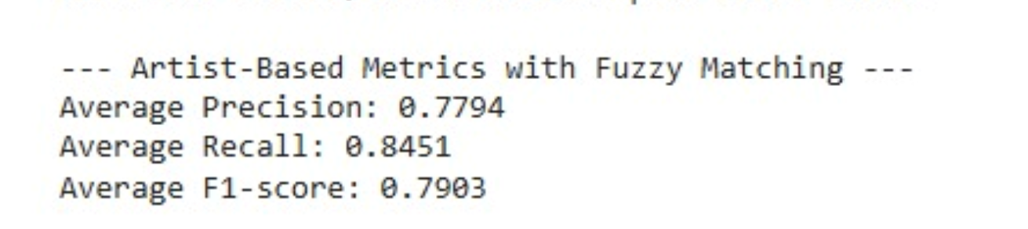
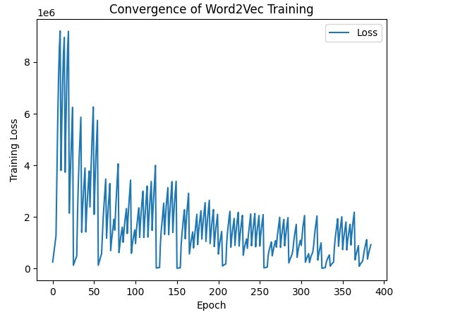
08
APPENDIX
APPENDIX 2
Fuzzy Matching

Slide 10
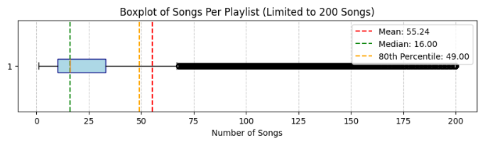
09
APPENDIX
APPENDIX 3
Distribution of songs per playlist

Slide 11
10
APPENDIX
APPENDIX 4
Word2vec VS. Triplet Loss model
Triplet Loss Model | Word2Vec | Aspect
Siamese Network with Triplet Loss | Skip-gram embedding model | Model & Training
Learn context-aware song embeddings | Embed songs to capture relationships | Goal
Triplets: Anchor, Positive, Negative songs | artist names as tokens | Input Data
Triplet Loss (minimizing anchor-positive distance vs. anchor-negative) | Skip-gram | Best Training Method
Song embeddings optimized for playlist context | Song embeddings in a vector space | Output
Precision@K, Recall@K, MAP | F1-Score, Precision@K, Recall@K | Evaluation Metrics
Model ??? with MAP of ???% | Model 3 (F1: 82.3%) | Best Performance
Computationally expensive, sensitive to sampling | Easy to implement, good for large datasets | Strengths
Computationally expensive, sensitive to sampling | Struggles with playlist-specific context | Weaknesses
Context-aware playlist creation | General song recommendations | Use Case Fit
GPU | CPU | computational requirements

Slide 12
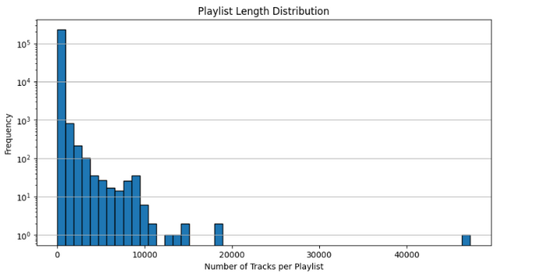
10
APPENDIX
Original data
After data cleaning and preprocessing
EDA
user_id: 1,048,575
unique artists: 279,658
unique users: 15,898
track_name: 1854971
playlist_name: 143640
song_name: 2658530
unq_playlist_name: 230708
Removing outliers:
by song_name (<43)
Keeping songs that appear in at least 10 different playlists
include playlists with >10 and < 50 songs
Over 12.7 million rows
Handle missing values and duplicate Rows.
Convert all string columns to lowercase, Standartizing text to ASCII, Removing one-char artists and track names.
Generating 2 new features to handle duplicate track names and playlist names:
songe_name, unq_playlist_name.
4 features:
user_id is a hash of the user's Spotify user name
artistname is the name of the artist
trackname is the title of the track
playlistname is the name of the playlist that contains this track.

